Slide 1
ANPR system
Submitted by: Nishikanta Parida
Regd no: 2124100015
Guided by: Dr. Debasis Gountia

Slide 2
CONTENT
Introduction
Problem Statement
Objective
Proposed Solution
Methodology
Types of Model
Code and Structure
Accuracy Comparison
Results

Slide 3
INTRODUCTION
Automatic number-plate recognition (ANPR) is a technology that uses object detection and optical character recognition on images to read vehicle registration plates.
In this ANPR system, we used an object detection model to identify the licence plate from the image/frame and then applied Optical character recognition(OCR) to get the licence plate number from it.

Slide 4
PROBLEM STATEMENT
ANPR a key technique in most of traffic related applications and is an active research topic in the image processing domain.
But due to the varying characteristics of the license plate from country to country like numbering system, colours, language of characters, style (font) and sizes of license plate, further research is still needed in this area.

Slide 5

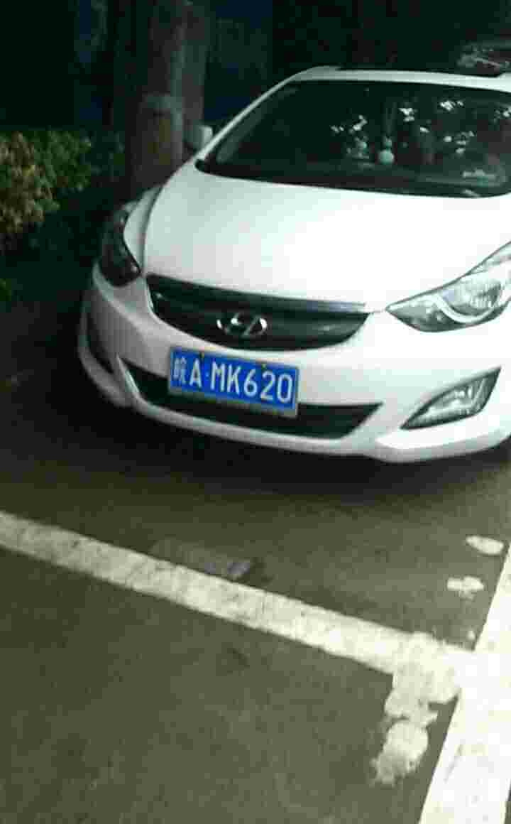
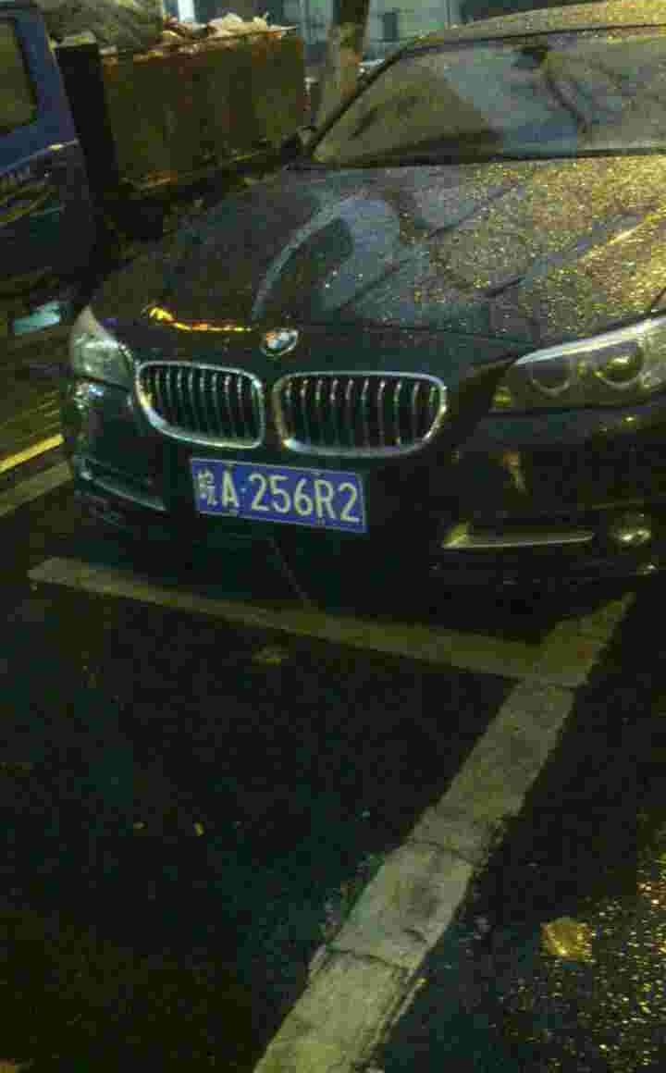
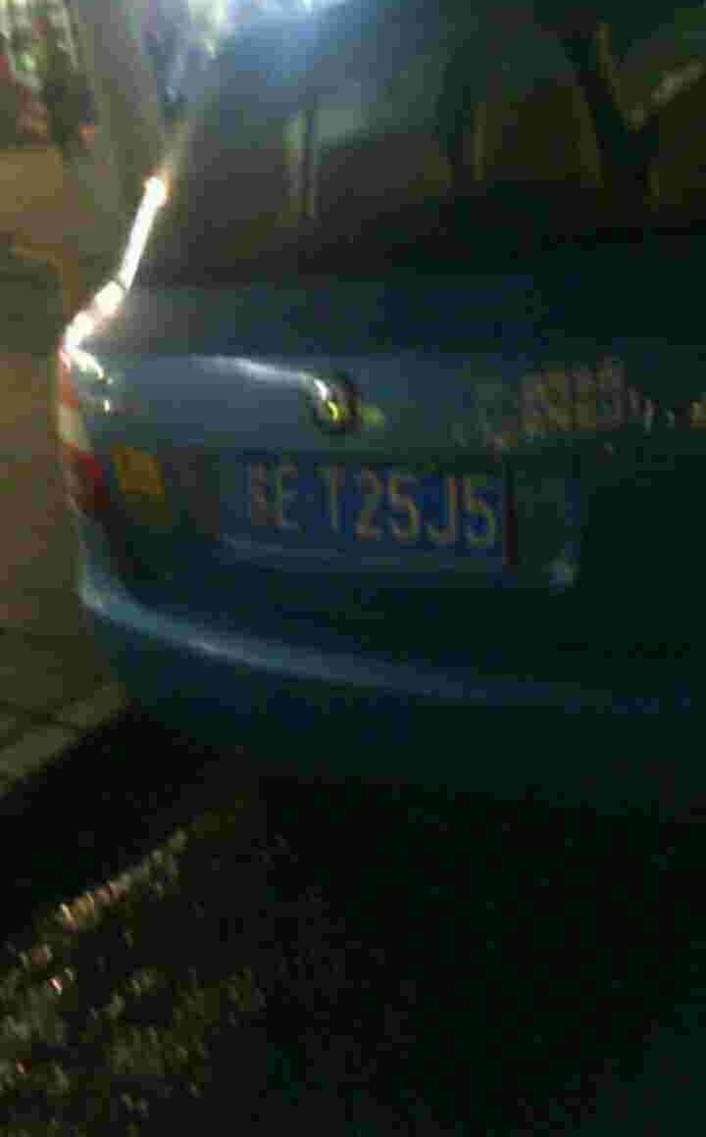

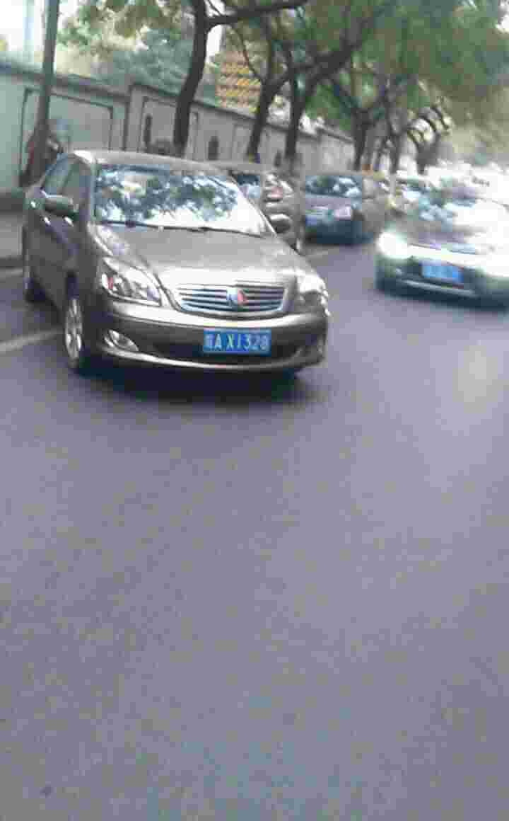


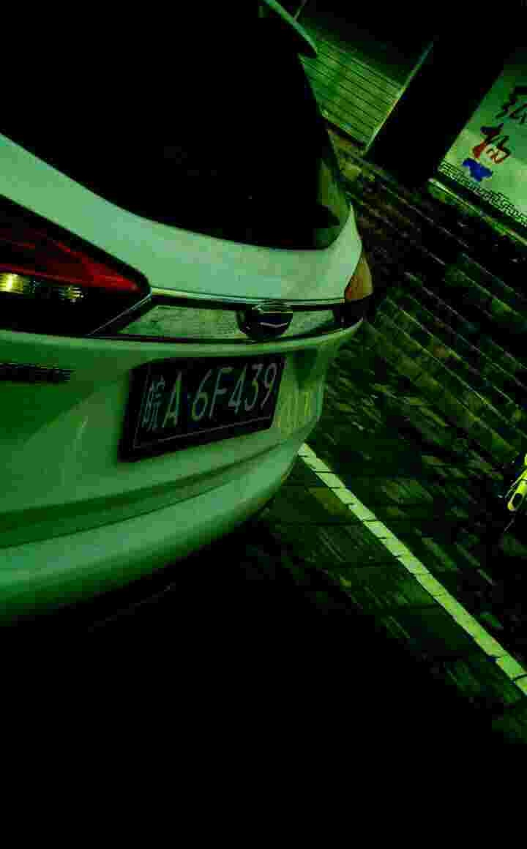
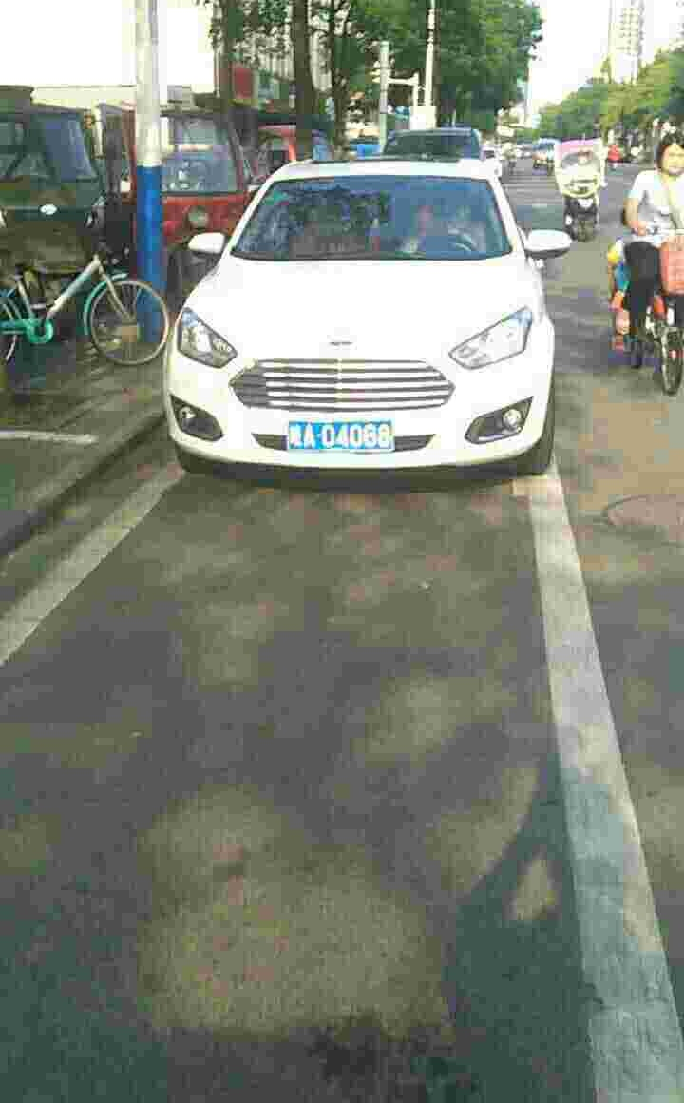

Slide 6
OBJECTIVE
The objective of this project is to build an efficient automatic number plate recognition system which can extract the number plates of vehicles from a frame.

Slide 7
PURPOSED SOLUTION
Our proposed solution is to implement the ANPR system by Transfer Learning method using TensorFlow Object Detection model and “easy ocr.”
And an other model(RPnet) using deep convolutional neural network to perform detection and recognition in one model.

Slide 8
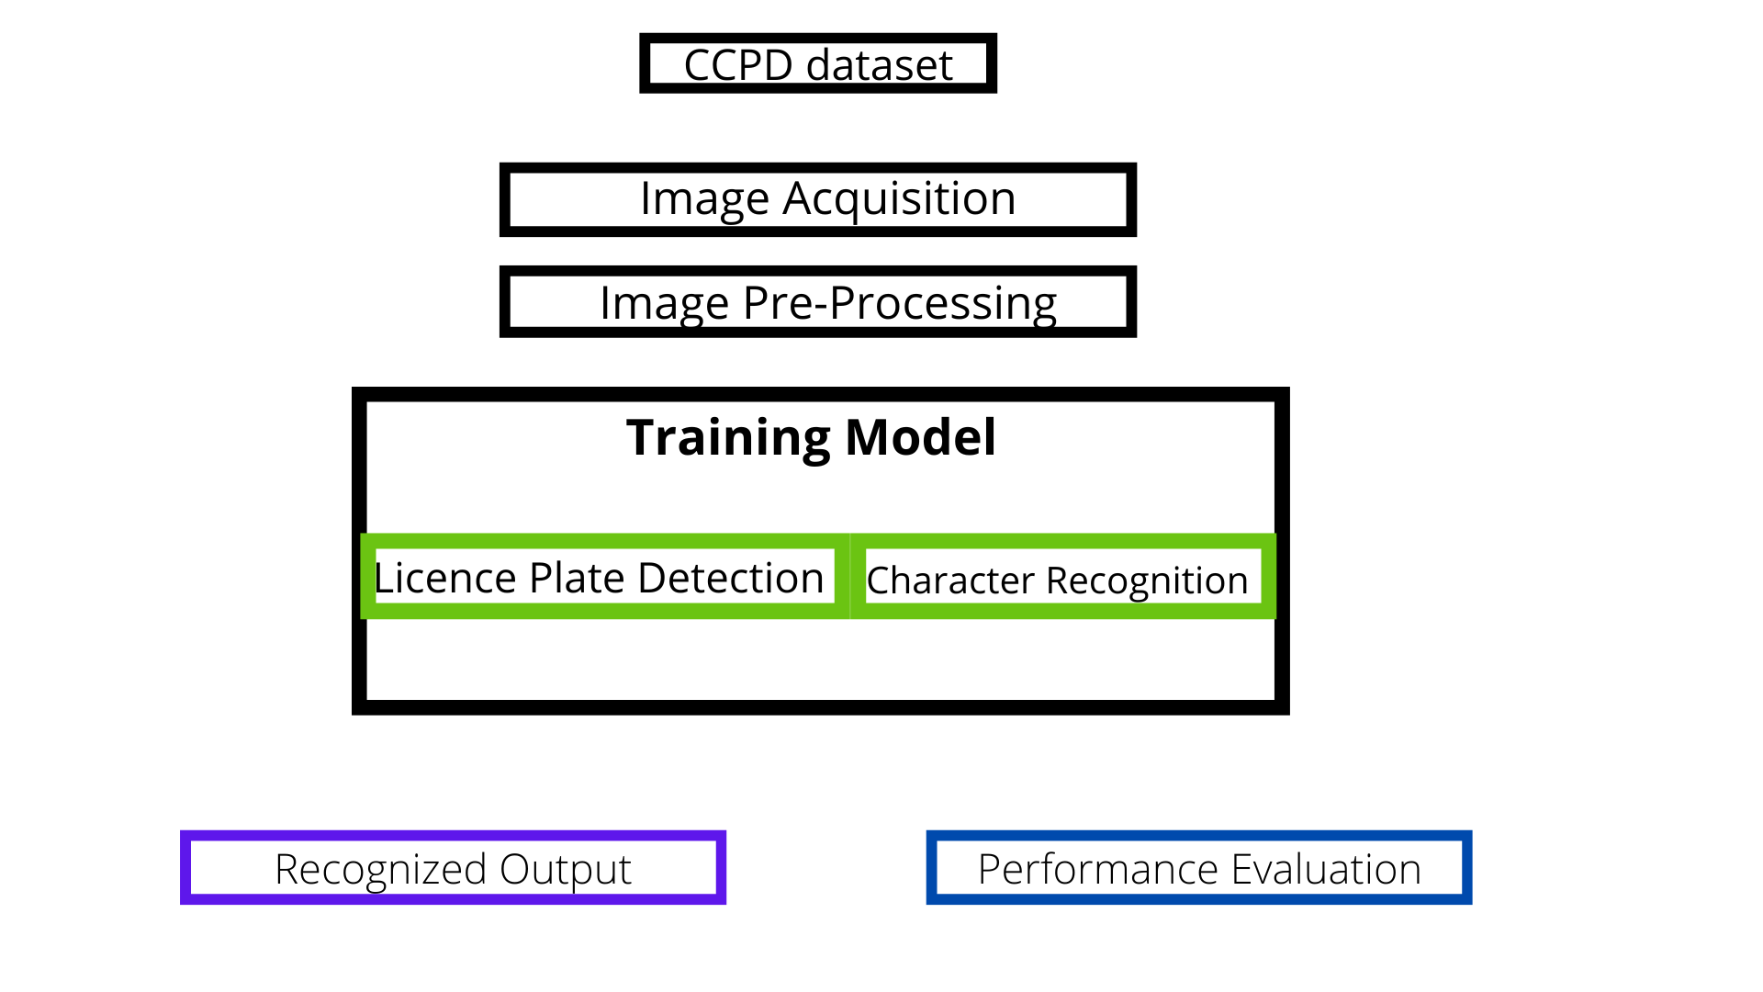
Methodology

Slide 9
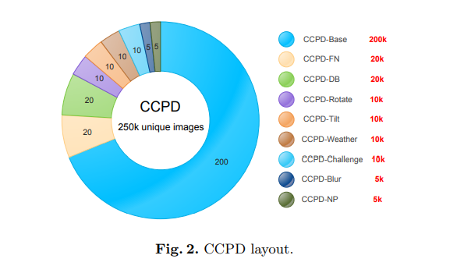
Chinese City Parking Dataset(CCPD)

Slide 10
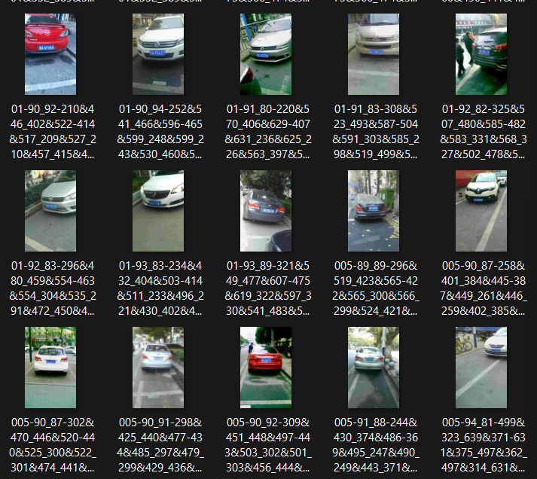
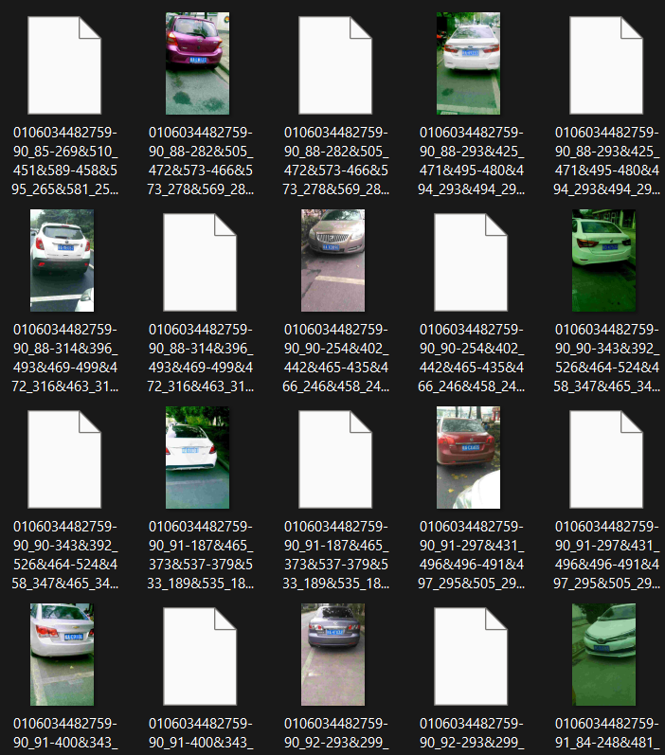
Before
After

Slide 11
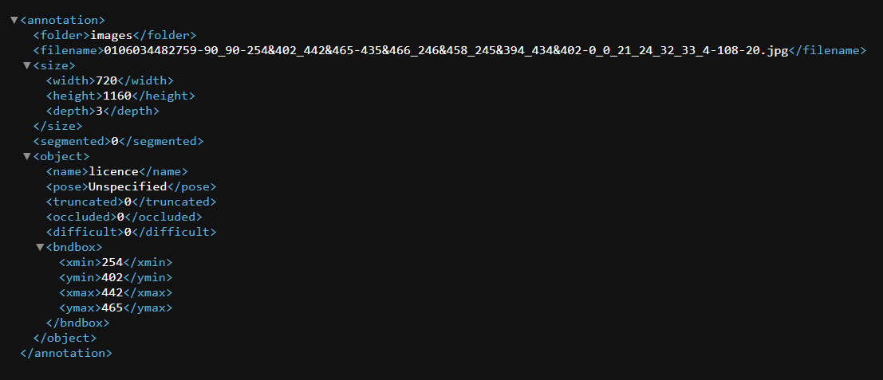

Slide 12
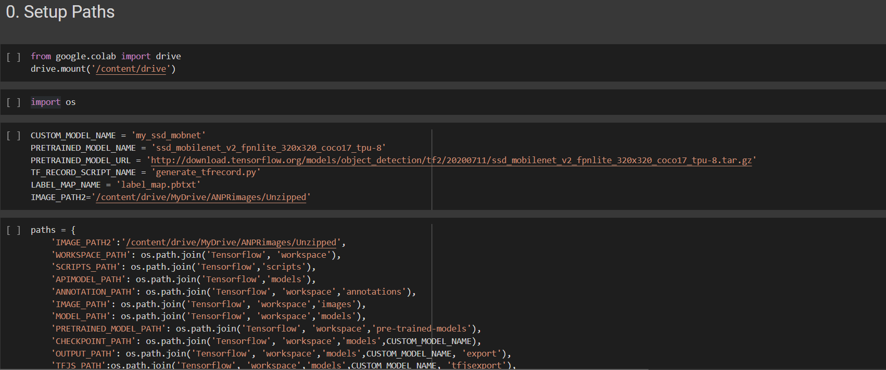
Code
(TensorFlow model)

Slide 13
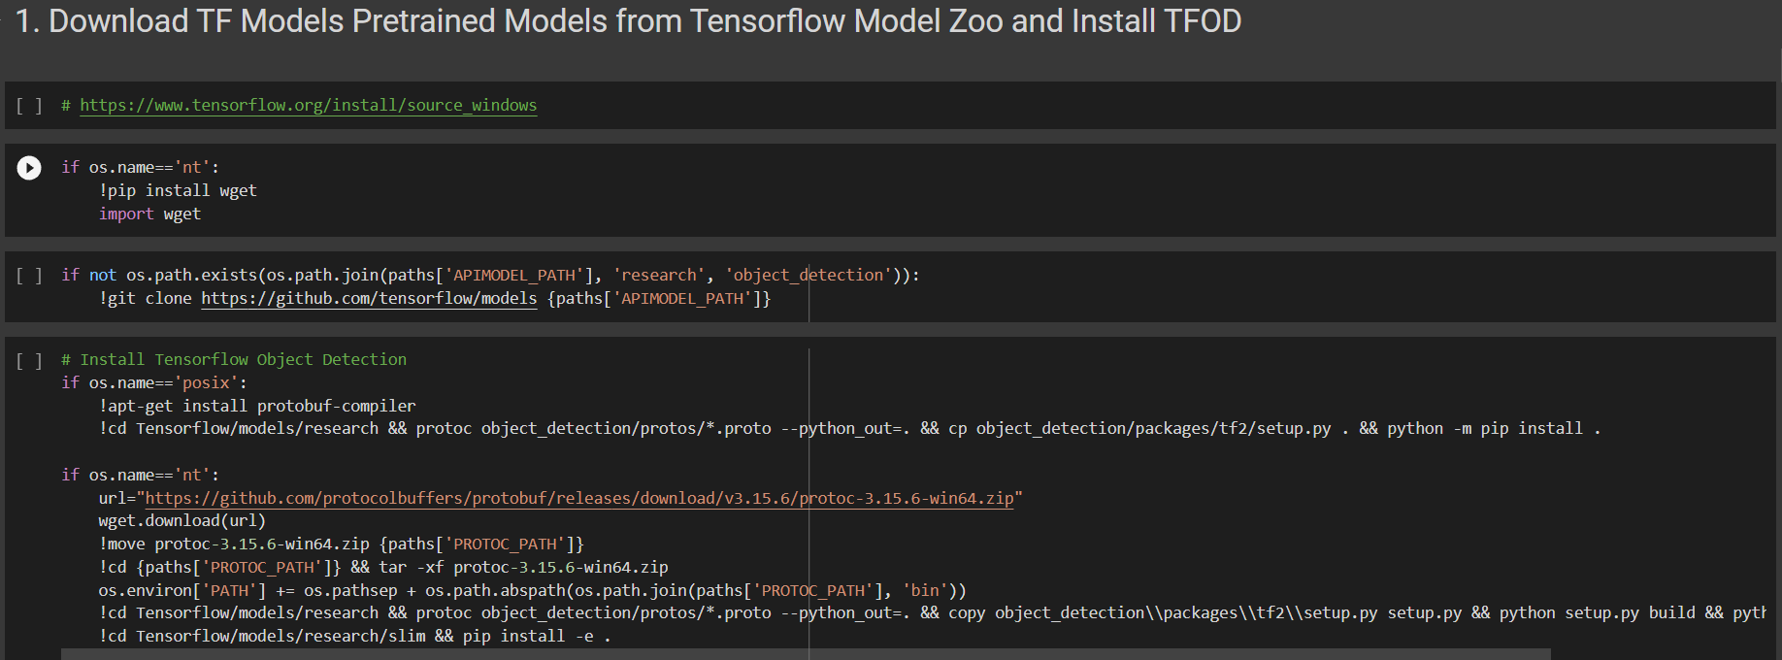

Slide 15
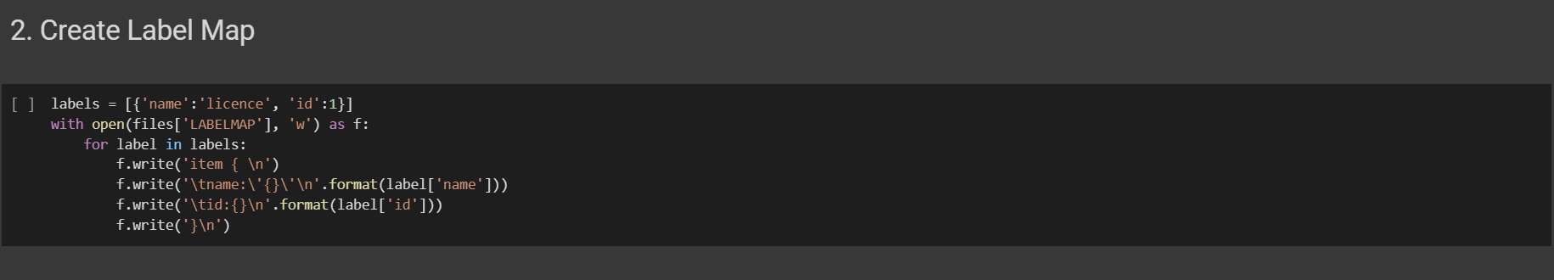

Slide 16
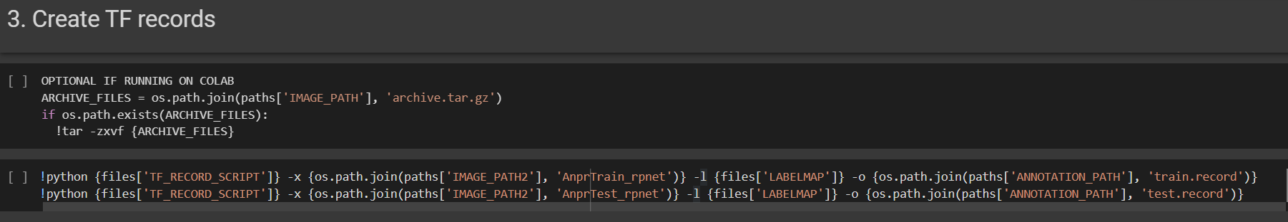

Slide 17
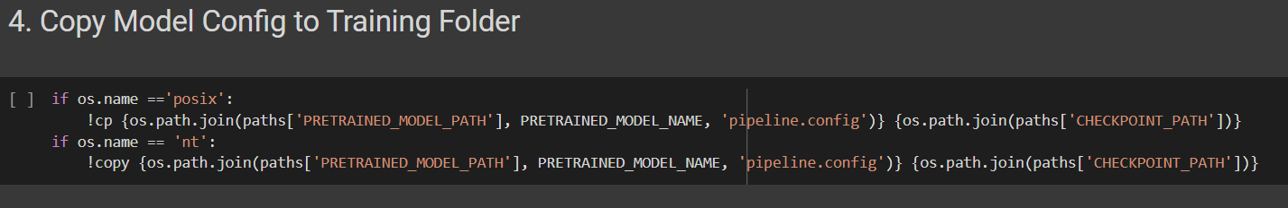

Slide 18
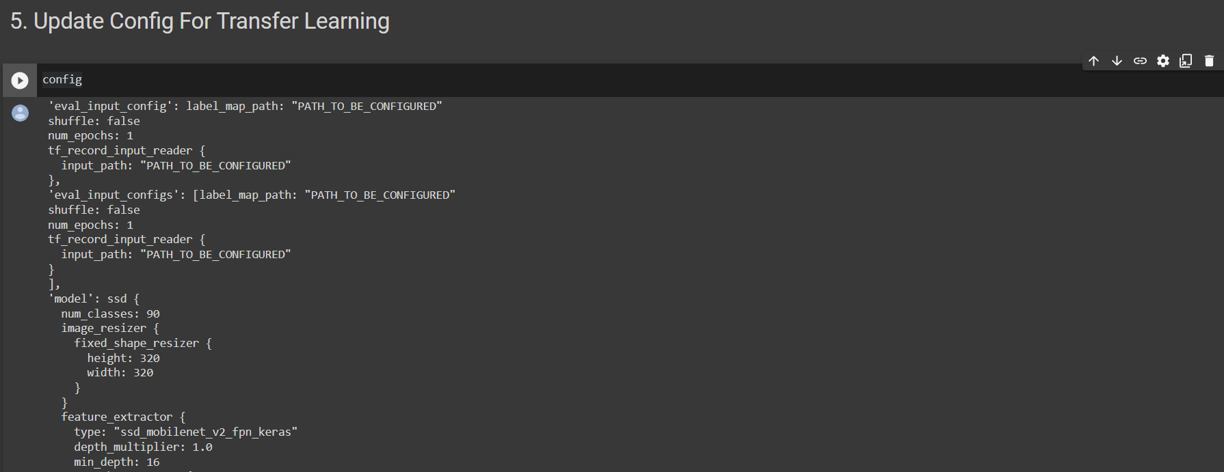

Slide 19
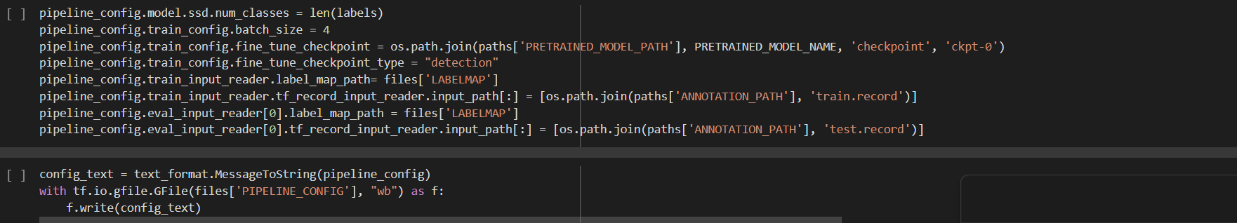

Slide 20
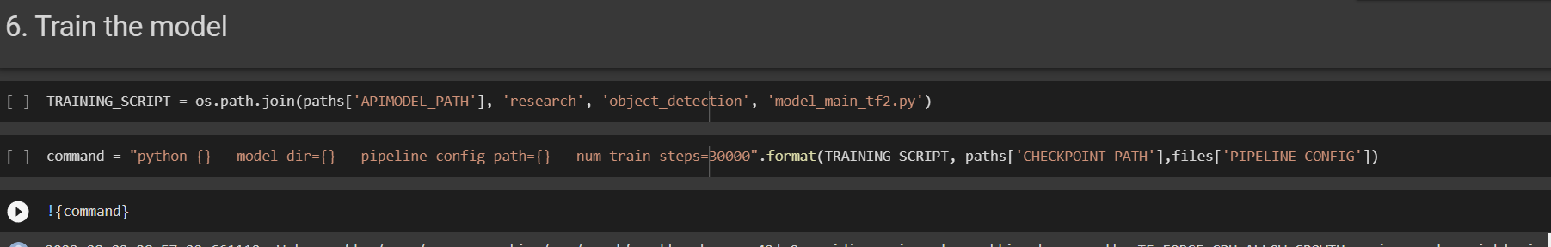

Slide 21
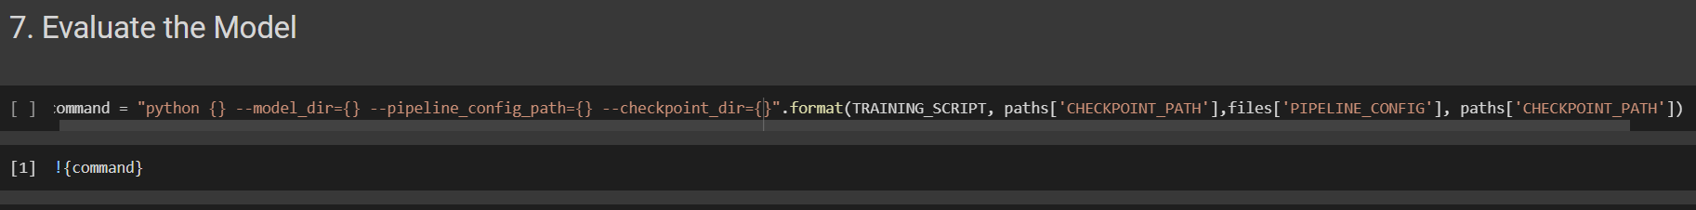

Slide 22
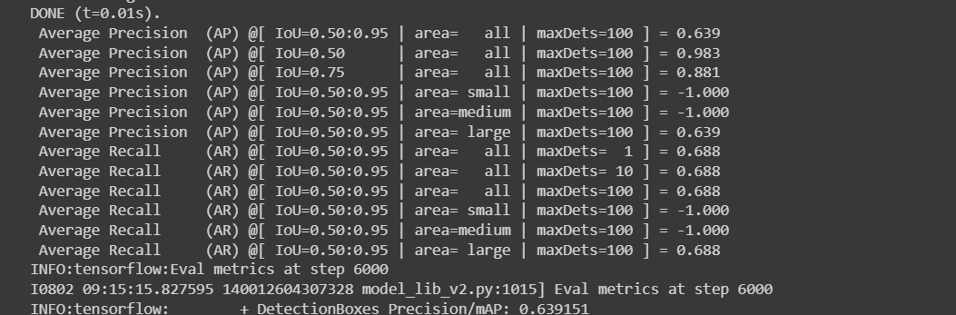
ACCURACY METRICS :
mAP (mean Average Precision) : 0.88
MODEL SIZE : 11MB

Slide 23
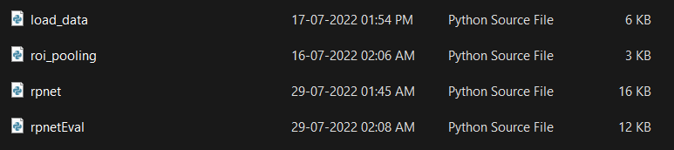

Code (RPnet)

Slide 24
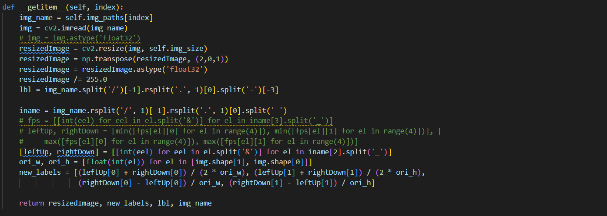
load_data.py

Slide 25
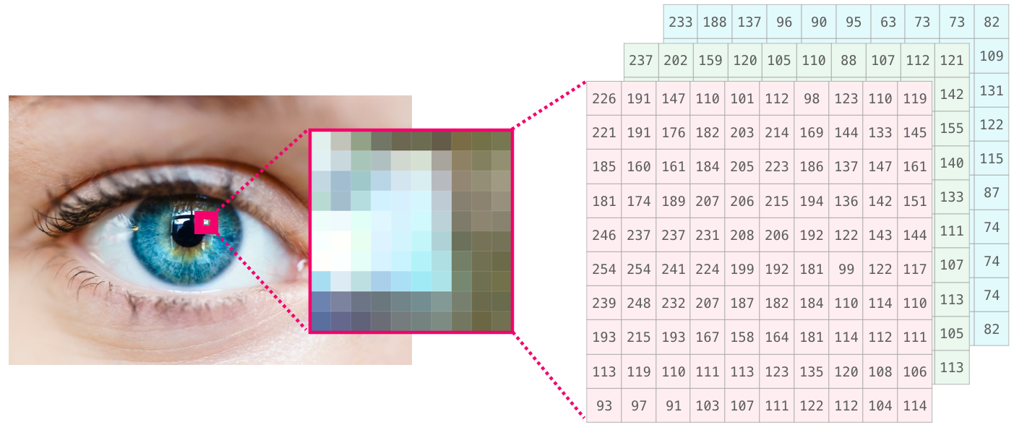

Slide 26
Region of Interest (ROI) pooling

Slide 27
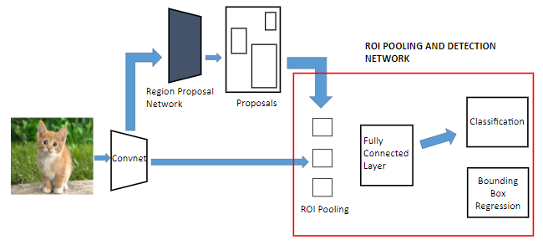
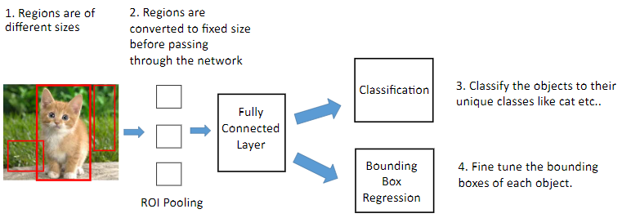

Slide 28
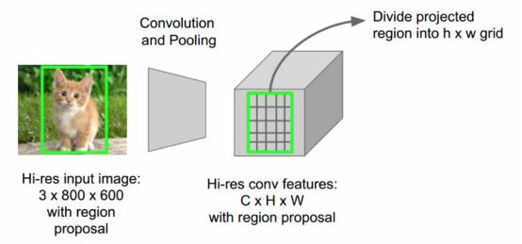

Slide 29
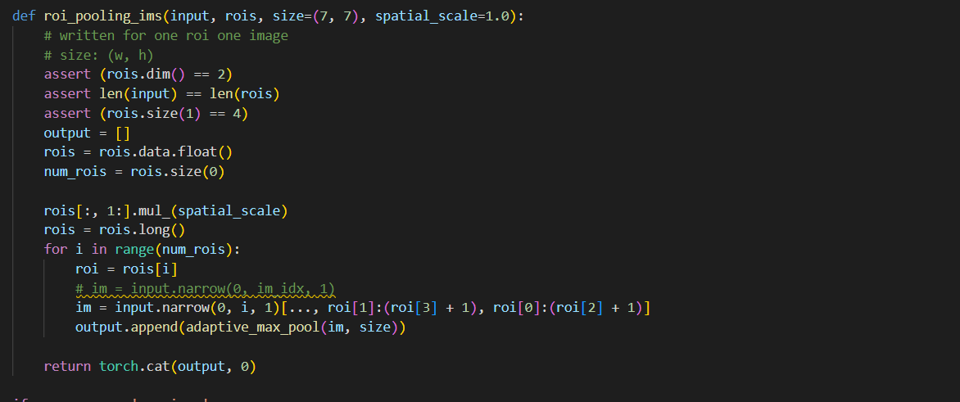
roi_pooling.py

Slide 30
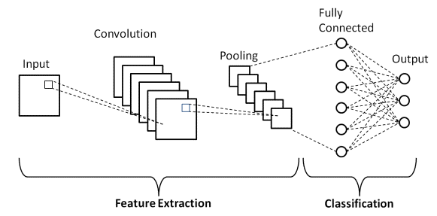
Convolutional neural network (CNN) Architecture

Slide 31
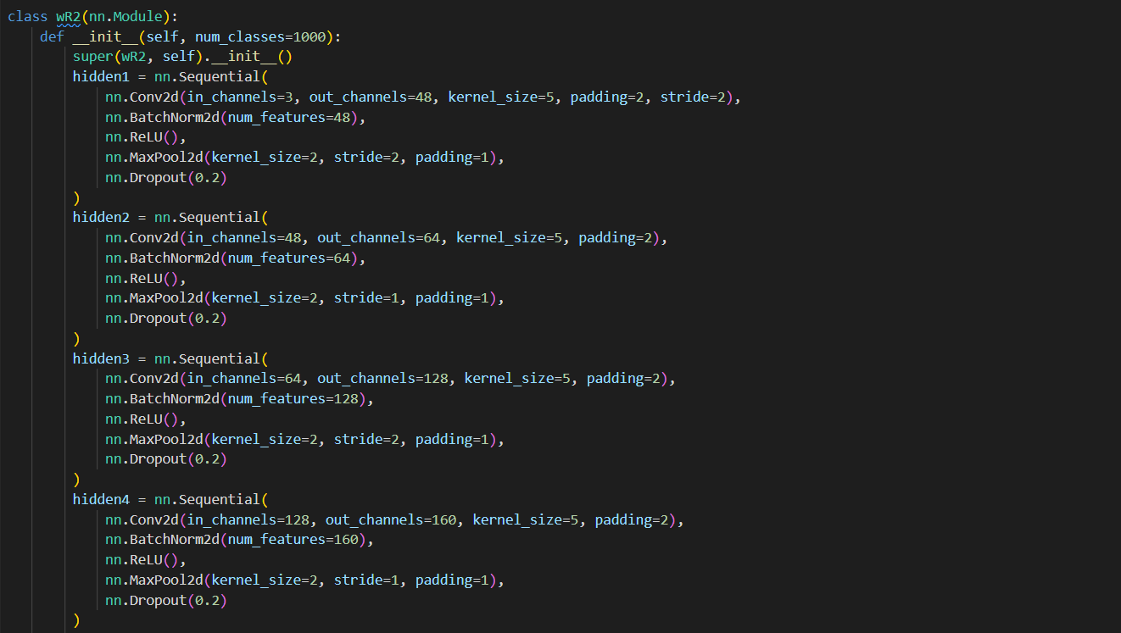
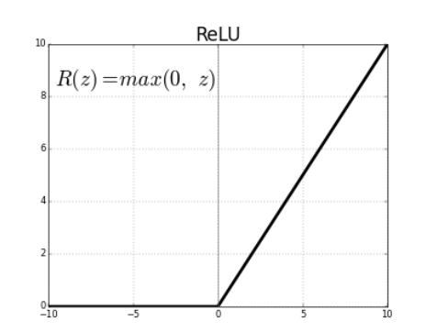
Rpnet.py

Slide 32
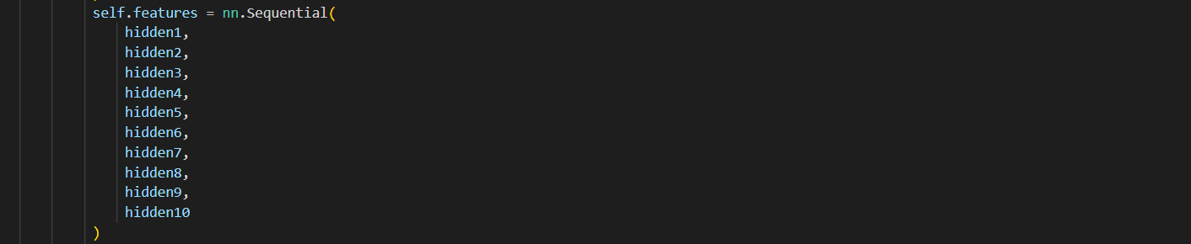

Slide 34
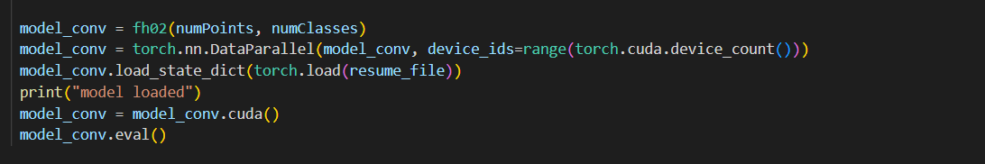
rpnetEval.py

Slide 35
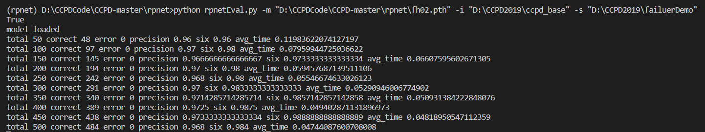
ACCURACY METRICS :
mAP (mean Average Precision) : 0.97
MODEL SIZE : 210MB

Slide 36
MODEL COMPARISON

Slide 37
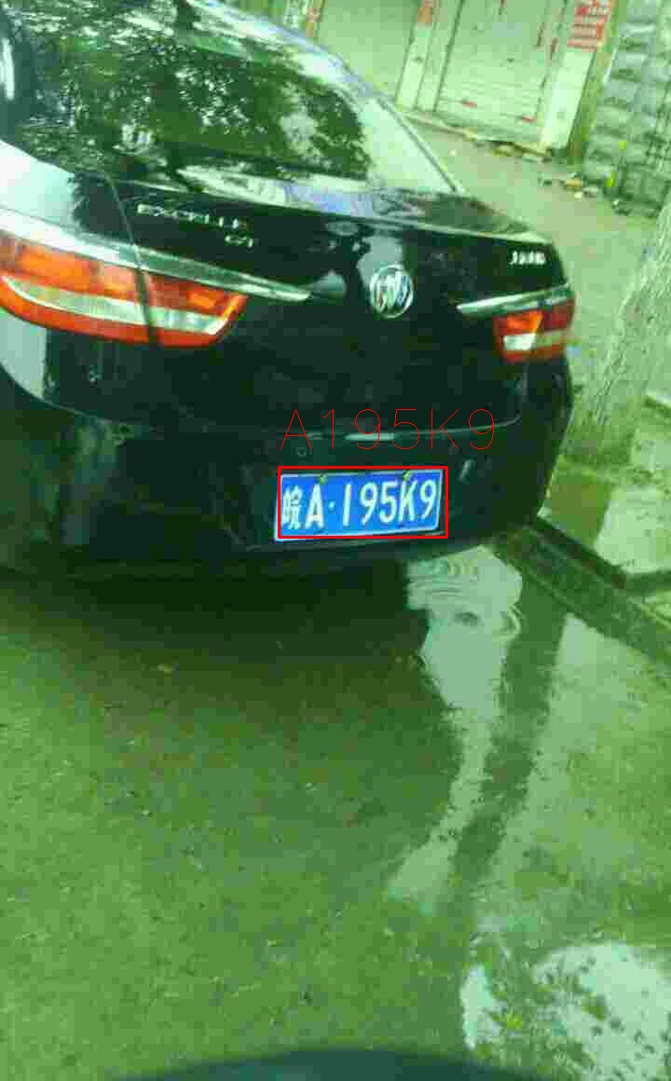
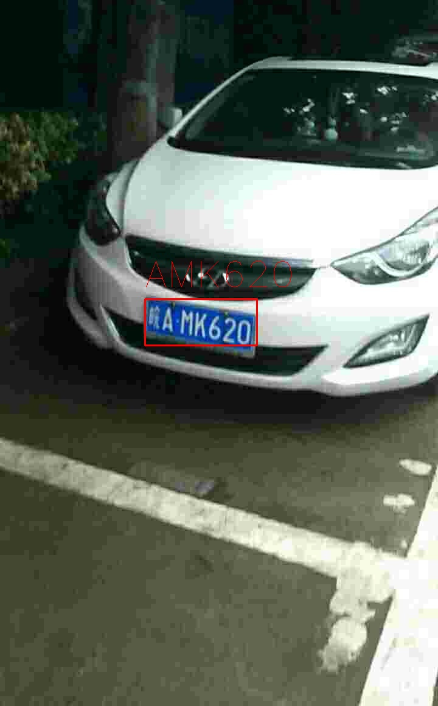


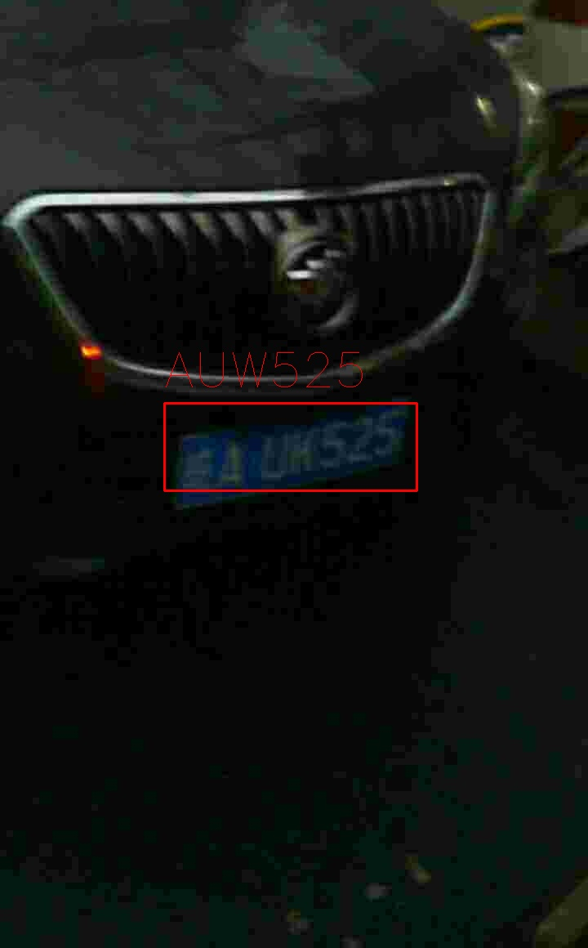
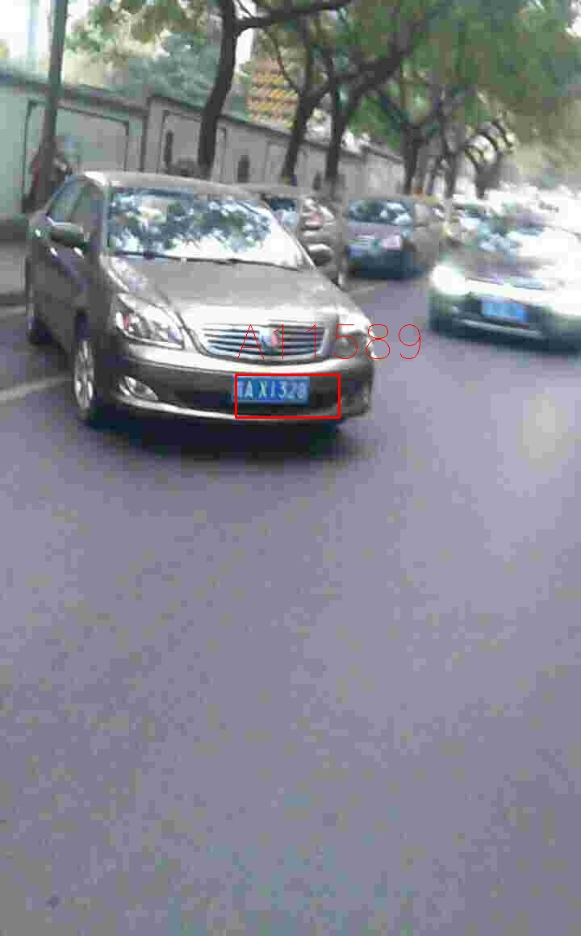
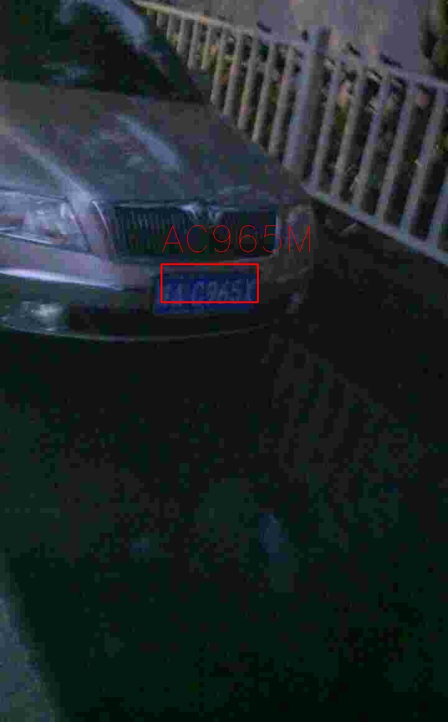
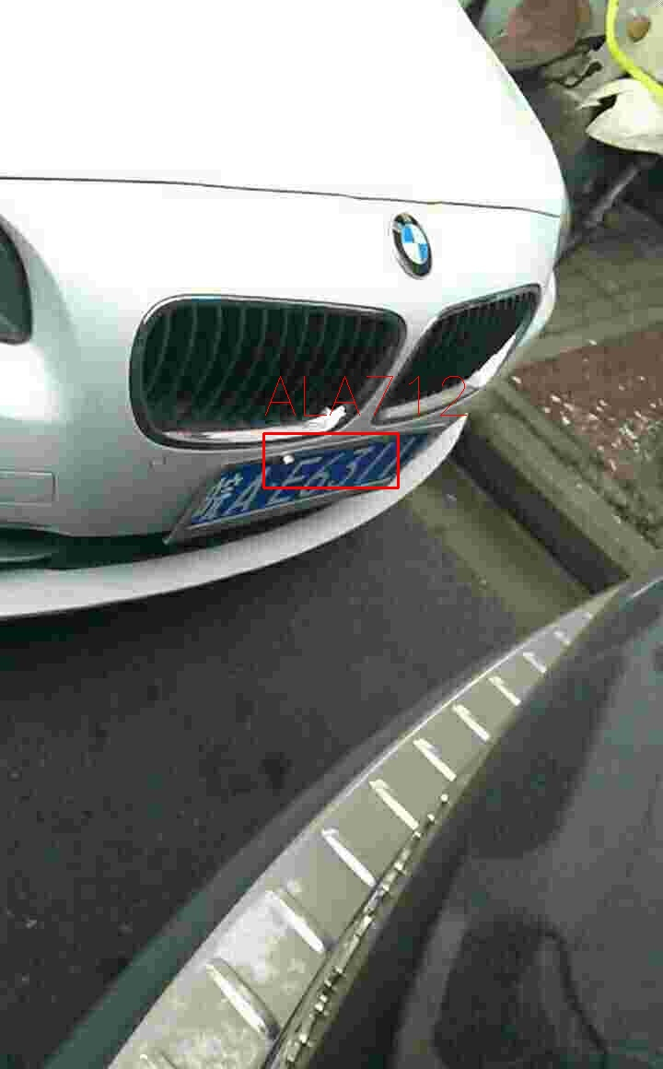
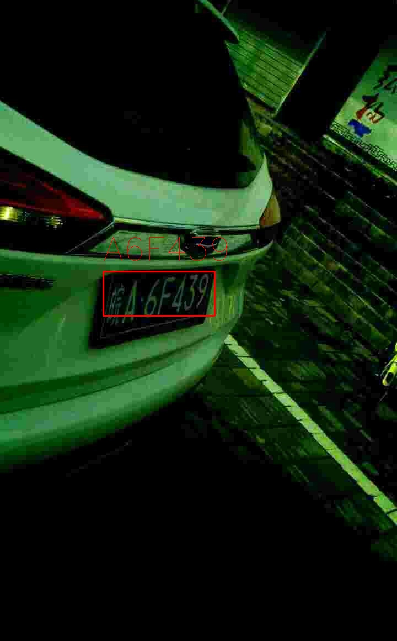
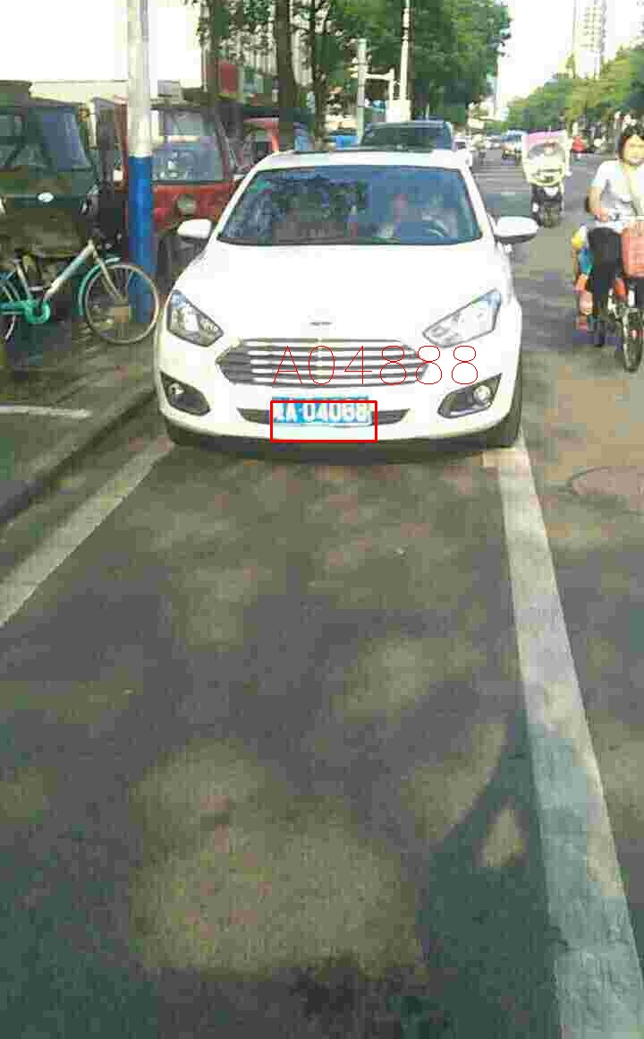

Slide 38
Reference
TensorFlow-
https://www.tensorflow.org/
TensorFlow Object Dectection -
https://www.tensorflow.org/lite/examples/object_detection/overview
EasyOcr –
https://pyimagesearch.com/2020/09/14/getting-started-with-easyocr-for-optical-character-recognition/
End-to-End License Plate Detection and Recognition: A Large Dataset and Baseline
CCPD Rpnet - https://github.com/detectRecog/CCPD
PP-OCR: A Practical Ultra Lightweight OCR System
https://paperswithcode.com/paper/pp-ocr-a-practical-ultra-lightweight-ocr

Slide 39
Thank You

